Slide 1
Image Representation

Slide 2
Outline
Pixel
Graphics Image
Color Model (RGB, CMY)
Direct Coding
Lookup Table
Printing
Books
References

Slide 3
Pixel
A pixel is one of the many tiny dots that make up the representation of a picture in a computer's memory.
Pixels in an image can be reproduced at any size without the appearance of visible dots or squares
The intensity of each pixel is variable; in color systems, each pixel has typically three or four dimensions of variability such as red, green and blue, or cyan, magenta, yellow and black

Slide 4
Pixel
Pixel View
Each cell in that grid is a pixel.
Each pixel has a color and brightness value.
When you zoom into an image, you eventually see these little squares.
Resolution
The total number of pixels defines the resolution.
For example:
A 1920×1080 image has 1920 pixels in width and 1080 pixels in height.
Total pixels = 1920 × 1080 = 2,073,600 pixels.

Slide 5
Pixel
Color representation
Each pixel stores color information, often in RGB (Red, Green, Blue) channels.
A pixel might look like this numerically:
Red = 200, Green = 120, Blue = 50.
Combining these values produces the final color.
Bit Depth
The number of bits used to store each pixel’s color.
8-bit per channel RGB → 24 bits per pixel (8 bits for R + 8 for G + 8 for B).
Higher bit depth = more possible colors.

Slide 6
Numeric Representation of Pixels
Grayscale (single channel)
Each pixel = 1 number = intensity (brightness).
Example:
8 bits per pixel → values 0–255
0=black
255=White
128=Mid Gray

Slide 7
Numeric Representation of Pixels
Color (RGB)
Each pixel = 3 components:
Red intensity
Green intensity
Blue intensity
Example:
24-bit RGB:
8 bits for Red (0–255)
8 bits for Green (0–255)
8 bits for Blue (0–255)

Slide 8
Numeric Representation of Pixels
RGBA (with transparency)
Adds an Alpha channel for opacity:
8 bits for A: 0=fully transparent, 255=opaque.
32 bits per pixel (8×4 channels).

Slide 9
Pixel Space Allocation
The space allocated depends on:
Image width and height
Bits per pixel
Example:
Image size: 640×480 pixels
Format: 24-bit RGB (3 bytes per pixel)
Total pixels: 640 × 480 = 307,200 pixels
Bytes per pixel: 3 bytes (1 for R, 1 for G, 1 for B)
Total memory needed: 307,200 pixels × 3 bytes = 921,600 bytes ≈ ~900 KB

Slide 10
Pixel Storage in Memory
Pixels are stored sequentially row by row (called row-major order)
Row 0: pixel(0,0), pixel(1,0), pixel(2,0), ...
Row 1: pixel(0,1), pixel(1,1), ...
Each pixel occupies contiguous bytes
[R][G][B][R][G][B][R][G][B][R][G][B]
If you wanted to find the pixel at (x, y), you calculate its offset:
offset = (y * width + x) * bytesPerPixel

Slide 11
Determination of Pixel Color
When creating an image (e.g., from a camera or drawing)
A sensor (camera) measures light intensity for red, green, and blue at each location.
The sensor outputs numeric values for R, G, and B:
Example:
Pixel(0,0): R=100, G=150, B=200
Pixel(0,1): R=20, G=30, B=40
These values are stored in memory at the pixel’s offset.

Slide 12
Determination of Pixel Color
When loading an image file (e.g., PNG, JPEG)
The image file encodes pixel data in a compressed format.
Image libraries (like libpng or stb_image) decode the file and reconstruct each pixel’s color:
The decoder reads the encoded data.
For each pixel, it outputs RGB values.
These RGB values are stored in the allocated memory buffer.

Slide 13
Computation of Pixel Color
Each pixel has a fixed position (x,y) in the grid.
You calculate its offset in memory:
offset = (y * width + x) * bytesPerPixel
For example:
Pixel at (2,1) in a 4×3 RGB image:
offset = (1 * 4 + 2) * 3 = (4 + 2)*3 = 6*3 = 18
Read 3 bytes starting at offset 18:
Byte 18: R
Byte 19: G
Byte 20: B

Slide 14
Graphics Images
Raster (Bitmap) Images
Made of pixels arranged in a grid.
Each pixel holds color information.
Common formats: JPEG, PNG, BMP, GIF, TIFF.
Examples:
Photographs
Scanned documents
Digital paintings
Properties:
Resolution-dependent (scaling causes pixelation).
Stored as pixel data.

Slide 15
Graphics Images
Vector Images
Not made of pixels.
Defined by mathematical descriptions of shapes, lines, and curves.
Common formats: SVG, EPS, PDF (vector parts), AI.
Examples:
Logos
Icons
Diagrams
Properties:
Resolution-independent (scale infinitely without losing quality).
Stored as a list of instructions (e.g., “draw a circle of radius 10 at (x,y)”).

Slide 16
Raster Image Representation
The computer stores raster images as a matrix (2D array) of pixels, and each pixel is a collection of values describing color.
Common representations:
Grayscale Images
Each pixel = 1 value (intensity).
Example:
8-bit grayscale: 0 = black, 255 = white.
RGB Images
Each pixel = 3 values (Red, Green, Blue).
Stored as:
Interleaved: R, G, B per pixel (common)
Planar: separate planes for R, G, B (less common)

Slide 17
Vector Image Representation
Vector images store commands describing shapes
The renderer interprets the commands to draw the shape
No pixels stored directly.

Slide 18
Graphics Image File Format
Raster Image
[ 0, 50, 255],
[100, 150, 200]]
Vector image
<circle cx="50" cy="50" r="40" fill="red"/>

Slide 19
Color Model
A color model is a mathematical way to describe and represent colors using numbers.
In other words, it defines how colors are organized and specified.
When you load or save an image, the file format must indicate which color model is being used so the image can be interpreted correctly.

Slide 20
Color Model
Color Model | Components | Used For
RGB | Red, Green, Blue | Screens, cameras, most images
CMYK | Cyan, Magenta, Yellow, Black | Printing
HSV | Hue, Saturation, Value | Color selection tools
HSL | Hue, Saturation, Lightness | Graphics editing
YCbCr | Luma (Y), Blue diff (Cb), Red diff (Cr) | Video compression (JPEG, MPEG)
LAB | Lightness (L), A (green–red), B (blue–yellow) | Color correction, device-independent color

Slide 21
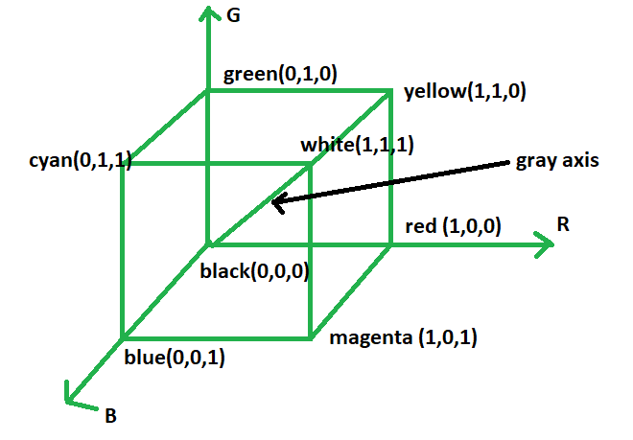
RGB Color Model
RGB is the standard model for digital color on screens.
It uses light mixing (Additive), not pigment.
It’s stored as 3 values per pixel.
It’s device-dependent: colors may look different on different displays.

Slide 22
How RGB Works?
Colors are created by adding light of different wavelengths (intensities).
The more you add, the closer you get to white.
Each channel can make 255 colors. So total available color is 16,777,216 colors (256×256×256).
The computer hardware sends these values to your display.
The display controls the intensity of the red, green, and blue subpixels behind each pixel.
These colored lights mix and produce the final visible color.

Slide 23
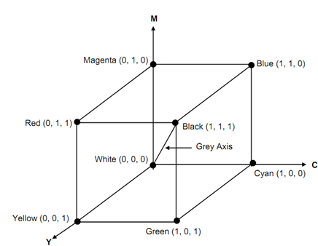
CMYK Color Model
CMYK (Cyan, Magenta, Yellow, Black) is a subtractive color model.
Used in color printing (e.g., magazines, brochures, packaging).
Colors are created by subtracting light (absorbing wavelengths).More ink = darker color.No ink = white paper reflects all light.

Slide 24
CMYK Color Model
K in CMYK
RGB from CMYK
Mixing 100% of cyan + magenta + yellow does not make a pure deep black (it makes a muddy dark brown).
Adding black ink (K) creates better shadows and text.
K also reduces ink consumption.
Cyan + Magenta = Blue
Cyan + Yellow = Green
Magenta + Yellow = Red
All three together + K = Deep Black

Slide 25
How CYMK Works?
In CMYK, adding inks makes things darker (more light absorbed). For example: Cyan ink absorbs red light. Magenta ink absorbs green light. Yellow ink absorbs blue light.
Start with white (plain paper).
Each ink layer absorbs some part of the light.
Combining inks absorbs more wavelengths, producing darker colors.
Representation:
[Cyan %] [Magenta %] [Yellow %] [Black %]

Slide 26
RGB to CMYK Conversion
Normalize RGB (0-1)
R' = R / 255
G' = G / 255
B' = B / 255
Compute K (black):
K = 1 − max(R', G', B')Compute C, M, Y:x(R', G', B’)
if,
K == 1 (pure black), then: C=0, M=0, Y=0
Otherwise,
C = (1 − R' − K) / (1 − K)
M = (1 − G' − K) / (1 − K)
Y = (1 − B' − K) / (1 − K)

Slide 27
RGB to CMYK Conversion (Example)
Yellow RGB (255,255,0)
R' = 1.0
G' = 1.0
B' = 0.0
K = 1 − max(1.0,1.0,0.0) = 0
C = (1−1−0)/(1−0) = 0
M = (1−1−0)/(1−0) = 0
Y = (1−0−0)/(1−0) = 1
C=0, M=0, Y=1, K=0

Slide 28
CMYK to RGB Conversion
R = (1 - C) * 255.0,
G = (1 - M) * 255.0,
B = (1 - Y) * 255.0

Slide 29
CMYK to RGB Conversion (Example)
C = 0.5, M=0.5, Y=0.5
R = (1−0.5) ∗ 255 = 127.5 ≈ 128
G = (1−0.5) ∗ 255 = 128
B= (1−0.5) * 255 =128

Slide 30
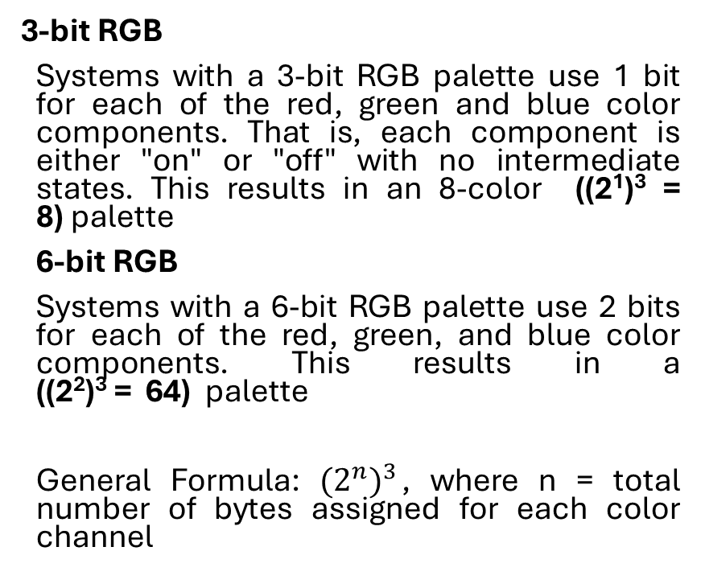
Bit Depth
Bit depth is the number of bits used to represent the color (or brightness) information of a single pixel channel in an image.
It tells you how many different values you can store for each component.
The higher the bit depth, the more precise the color.
3-bit RGB
Systems with a 3-bit RGB palette use 1 bit for each of the red, green and blue color components. That is, each component is either "on" or "off" with no intermediate states. This results in an 8-color ((2¹)³ = 8) palette
6-bit RGB
Systems with a 6-bit RGB palette use 2 bits for each of the red, green, and blue color components. This results in a ((2²)³ = 64) palette
General Formula: ${(2^{n})}^{3}$, where n = total number of bytes assigned for each color channel

Slide 31
Color Storage: Direct Coding
Choose a Color Model
The most common is RGB (Red, Green, Blue). Other models like CMYK or Grayscale can also be used.
Assign Bit Depth
This defines how many bits are used to represent each color component.
For 24-bit RGB:
Red = 8 bits (0–255)
Green = 8 bits (0–255)
Blue = 8 bits (0–255)
Total per pixel = 24 bits = 3 bytes
Store the Color Per Pixel
Each pixel in the image grid stores actual RGB values
Pixel | R | G | B
(0,0) | 255 | 0 | 0
(0,1) | 0 | 255 | 0
(1,0) | 0 | 0 | 255
(1,1) | 255 | 255 | 0

Slide 32
Color Storage: Lookup Table
LookUp Table
In this approach pixel values do not code colors directly. Instead, they are addresses or indices into a table of color values.
The color of a particular pixel is determined by the color value in the table entry that the value of the pixel references.

Slide 33
Printing
A printer deposits color pigments onto a print media, changing the light reflected from its surface and making it possible for us to see the print result.
Given the fact that the most commonly used print media is a piece of white paper, we can in principle utilize three types of pigments (cyan, magenta, and yellow) to regulate the amount of red, green, and blue light reflected to yield all RGB colors
While some printing methods allow color pigments to blend together, in many cases the various color pigments remain separate in the form of tiny dots on the print media.
Halftone is a technique used to create the illusion of shades and gradients using only dots of varying size, shape and spacing. It is commonly used in printing, newspapers, and comic books to represent images with limited colors.

Slide 34
Halftone
Halftoning is a technique that simulates continuous-tone images (like photographs) using dots of varying size, spacing, or density, typically in black and white or a limited color palette.
It tricks the human eye into perceiving smooth shades of gray or color, even though the image is made up of only binary values (like black or white).
Use in Newspaper & magazine printing, Inkjet and laser printers, and so on

Slide 35
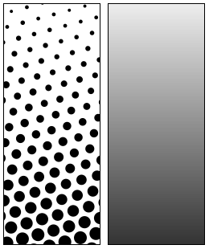
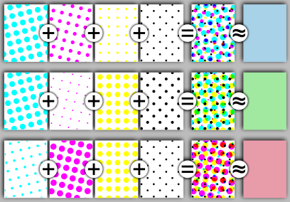
Halftone Visualization

Slide 36
The End

Slide 37
Books
Foley, van Dam, Feiner, Hughes, Computer Graphics: principles and practice, Addison Wesley, Second Edition.
Schaum's Outline of Theory & Problems of Computer Graphics.
Peter Shirley Steve Marschner , “Fundamental of computer graphics”, Third Edition.

